Slide 1
Intelligent Sensor Fusion using Deep Learning
By Asm Nurussafa

Slide 2
Agenda
Motivation
Sensor Fusion and Keras
Pre-processing dataset
Learning Model in Edge Impulse
Validation
Results
Summary

Slide 3
1. Motivation
Study: Using gas sensors to identify different types of drinks (tea, coffee etc.) using their odors.
Using sensor fusion and deep learning can be advantageous because-
Improved accuracy and robustness.
Ability to detect complex mixtures.
Real time monitoring and feedback.
Can be carried forward to various other fields.

Slide 4
2.1. Sensor Fusion
What is Sensor Fusion? Sensor fusion is the process of combining data from multiple sensors to obtain a more accurate and complete understanding of a particular environment or phenomenon. In our particular study, we will be using the feature-level fusion that extracts features from the raw data first before combining them. Then, we will involve multiple types of gas sensors to detect and analyze odors.

Slide 5
2.1. Keras
What is Keras? Keras is a deep learning framework that is often used specifically for building Convolutional Neural Networks (CNN). Keras provides a high level API that allows to define a NN model by selecting the type and number of layers, the activation functions to be used and other parameters making it easy to create complex models and then train and evaluate models.

Slide 6
3. Pre-processing Dataset

Slide 7
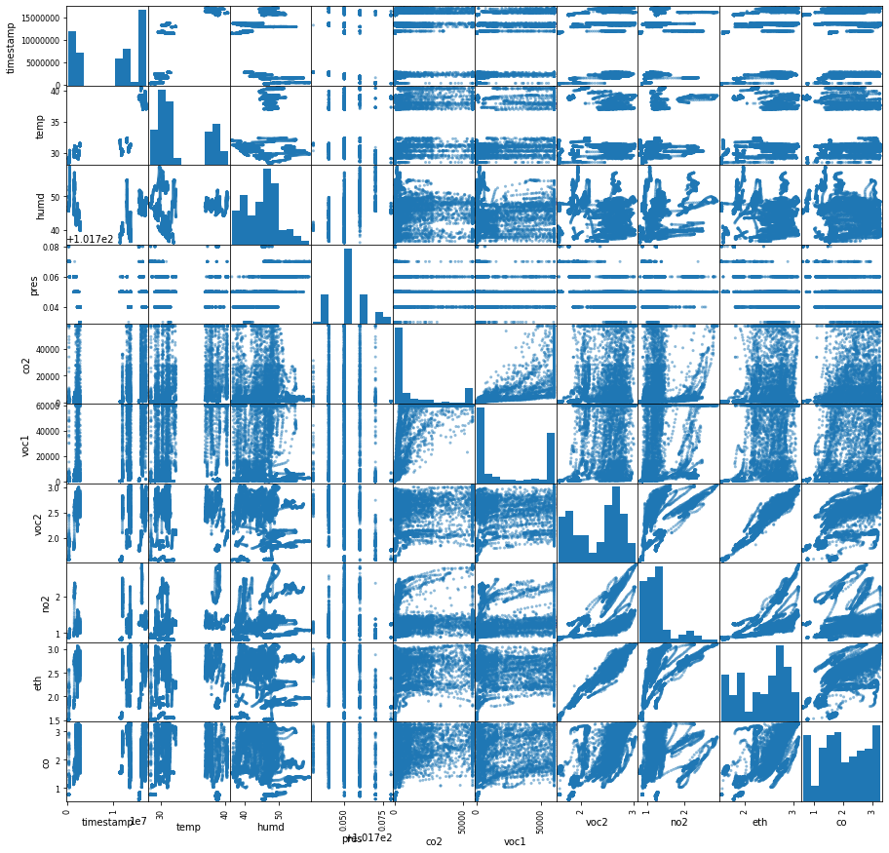
3.1. Visualizing dataset
For our study, we collected a raw dataset from that was recorded from multi-channel gas sensors. The dataset included data from different environments.
Fig 1: Data visualization for different parameters.

Slide 8
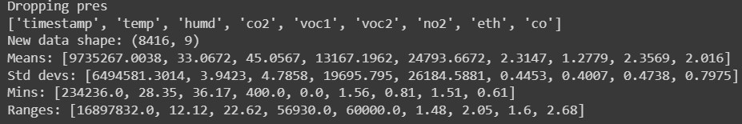
3.2. Pre-processing dataset
It is important to pre-process these raw data because of the wide range of values of each parameters. To do this, we use standardization and normalization techniques and then, use the data for training. For our study puposes, we calculated the mean, standar deviation, Mins and ranges for each input feature.
Fig 2: Pre-processed data.

Slide 9
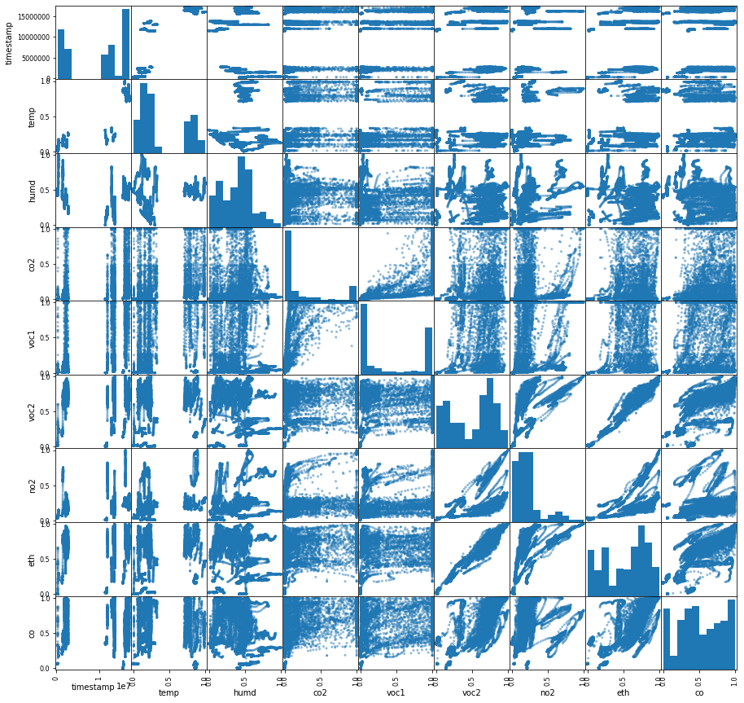
3.2. Pre-processed dataset
Fig 3: Pre-processed data.

Slide 10
4. Learning Model in Edge Impulse

Slide 11
4. 1. Uploading data to Edge Impulse
Edge Impulse is a free to use development for machine learning. It is very easy to use and gives more freedom to experiment with different kinds of models, allowing deployment to edge devices easily. We, then upload the saved pre-processed data to Edge Impulse with a default 80:20 default train:test split.

Slide 12
5. Summary
Using CNN as a deep learning method for odor detection is advantageous since it can automatically recognise complex patterns from the output signals of multiple sensors.
Sensor fusion provides a better understanding of an environment by combining datas from multiple sensors.
Edge Impulse is a very easy to use platform for developers to experiment with different kinds of machine learning models and then deploy these model to specific edge devices.
From this simple study, we can actually carry forward this idea into implementing more complex scenarios.

Slide 13
Thank you!
Any questions ?

